Slide 1
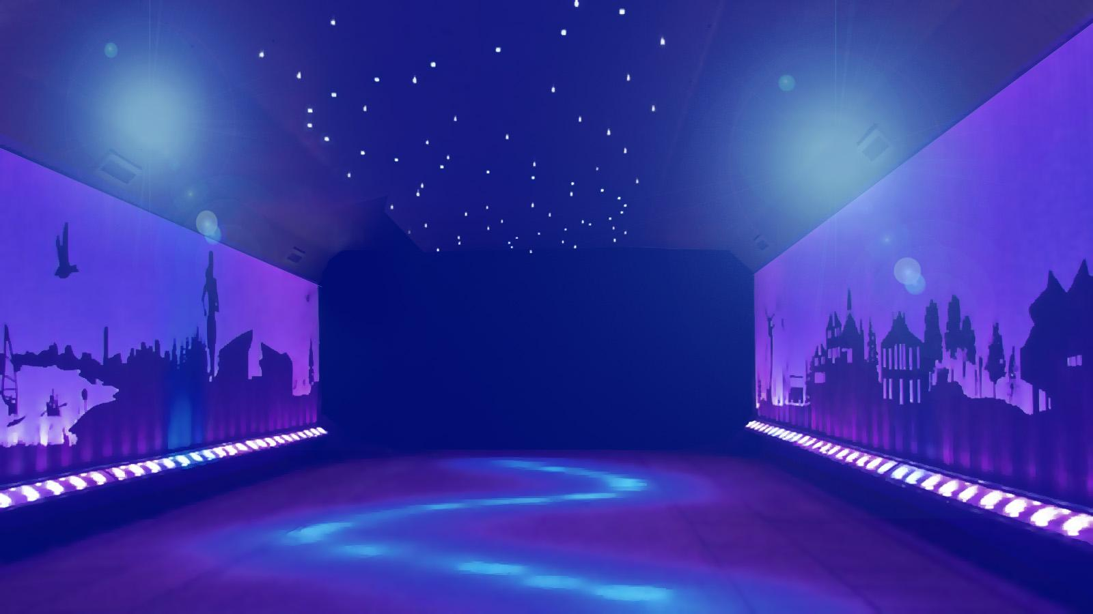

JEOPARODY JEOPARODY JEOPARODY JEOPARODY JEOPARODY JEOPARODY JEOPARODY JEOPARODY JEOPARODY JEOPARODY JEOPARODY JEOPARODY JEOPARODY JEOPARODY JEOPARODY JEOPARODY JEOPARODY JEOPARODY JEOPARODY
JEOPARODY JEOPARODY JEOPARODY JEOPARODY JEOPARODY JEOPARODY JEOPARODY JEOPARODY JEOPARODY JEOPARODY JEOPARODY JEOPARODY JEOPARODY JEOPARODY JEOPARODY JEOPARODY JEOPARODY JEOPARODY JEOPARODY

Slide 2
FAQ:
Q. Is this game officially licensed by Jeopardy!?
A. No it’s not. This game is a PARODY game.
Q. How do I reset the links on the main board back to yellow?
A. Simply close the PowerPoint file, and re-open, and the links will turn back to yellow.
Q. Why aren’t the sound effects working?
A. If the sound effects aren’t working, I would suggest upgrading your PowerPoint to something newer than 2008, and using a PC instead of a Mac if possible. Also, Google slides, Keynotes, etc. are not supported.
Q. Can I get a board with less categories? Can I add a custom logo?
A. Unfortunately these changes are a little too complex for me to explain or assist you via email, but if you’d like me to do a custom job for you for a small fee, send me an email at Reid@youthdownloads.com.

Slide 3
HERE ARE TODAY’S CATEGORIES

Slide 4

COMP SCI DEPT RESOURCES

Slide 5
METHODS

Slide 6
EXPRESSIONS

Slide 7
COMPUTER SCIENCE POTPOURRI
(po-pr-ee)

Slide 8
OBJECTS

Slide 9
PUNNY JOKES
(GAME BREAK)

Slide 10
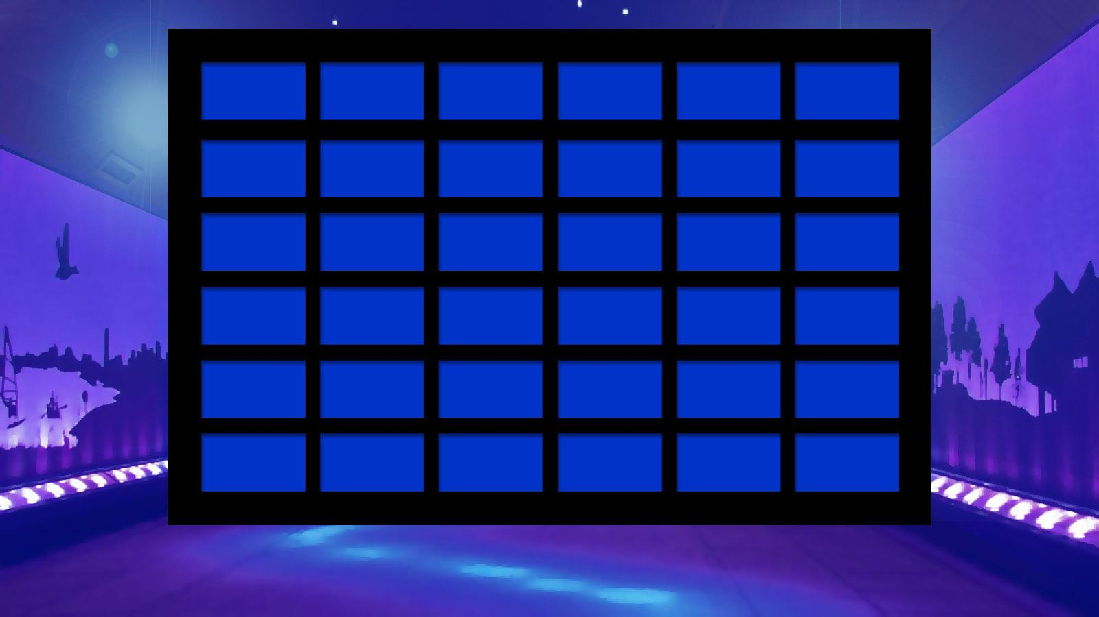
COMP SCI DEPT RESOURCES
METHODS
COMPUTER
SCIENCE POTPOURRI
PUNNY JOKES
EXPRESSIONS
OBJECTS
100
$100
$100
$100
$100
Joke1
200
$200
$200
$200
$200
Joke2
300
$300
$300
$300
$300
Joke3
400
$400
$400
$400
$400
Joke4
500
$500
$500
$500
$500
Joke5
FINAL JEOPARODY

Slide 11
COMP SCI DEPARTMENT RESOURCES for $100
This resource provides free drop-in tutoring for CS 200, CS 300, and CS 400

Slide 12
COMP SCI DEPARTMENT RESOURCES for $100​
What is the CSLC?

Slide 13
COMP SCI DEPARTMENT RESOURCES for $200
This resource is where you would go to discuss (with an actual person) which courses to take next semester as a comp sci major

Slide 14
COMP SCI DEPARTMENT RESOURCES for $200
What is CS Advising?

Slide 15
COMP SCI DEPARTMENT RESOURCES for $300
This CS 200 resource is what you would use to speak with your CS 200 instructors directly outside of the scheduled course time

Slide 16
COMP SCI DEPARTMENT RESOURCES for $300
What are CS 200 office hours?

Slide 17
COMP SCI DEPARTMENT RESOURCES for $400
In addition to CS 200, WES-CS also offers a study group for this course (Brand new this year :) )

Slide 18
COMP SCI DEPARTMENT RESOURCES for $400
What is CS 300?

Slide 19
COMP SCI DEPARTMENT RESOURCES for $500
This resource provides software and hardware support for the UW Computer Sciences Department

Slide 20
COMP SCI DEPARTMENT RESOURCES for $500
What is the CSL (Computer Systems Lab)?

Slide 21
METHODS for $100
Which of the following method headers does not return a value?
A. public static void main(String[] args){}
B. public static int getNum(int a, int b){}
C. private String subsetOfName(String name, int i){}
D. public char firstLetter(String word){}

Slide 22
METHODS for $100
Which of the following method headers does not return a value?
A. public static void main(String[] args){}
B. public static int getNum(int a, int b){}
C. private String subsetOfName(String name, int i){}
D. public char firstLetter(String word){}

Slide 23
METHODS for $200
Which of the following is NOT a reason to create a method in Java?
A. To decrease the code’s total footprint. (Use less lines of code)
B. To abstract away the details of a specific task.
C. To make code easier to read.
D. To be able to pass an object by reference.

Slide 24
METHODS for $200
Which of the following is NOT a reason to create a method in Java?
A. To decrease the code’s total footprint. (Use less lines of code)
B. To abstract away the details of a specific task.
C. To make code easier to read.
D. To be able to pass an object by reference.

Slide 25
METHODS for $300
Which of the following statements are true?
Math.pow(2, 2) is a static method
scnr.next() is a static method
myStr.equals(yourStr) is a static method
A. I only is true
B. I and II are true
C. II and III are true
D. I, II, and III are true

Slide 26
METHODS for $300
Which of the following statements are true?
Math.pow(2, 2) is a static method
scnr.next() is a static method
myStr.equals(yourStr) is a static method
A. I only is true
B. I and II are true
C. II and III are true
D. I, II, and III are true

Slide 27
METHODS for $400
Assuming word is a String object. Which of the following will not compile?
A. System.out.print(word);
B. int length = word.size();
C. word = word.trim();
D. String word2 = new String(“Hello World”);

Slide 28
METHODS for $400
Assuming word is a String object. Which of the following will not compile?
A. System.out.print(word);
B. int length = word.size();
C. word = word.trim();
D. String word2 = new String(“Hello World”);

Slide 29
METHODS for $500
Assume the following code is executed.
1 public static void main(String[] args) {
2 int myInt = 5;
3 double myDouble = 6;
4
5 System.out.println(coolAddition(myInt, myDouble));
6 }
7
8 public static double coolAddition(double x, int y) {
9 return x + y;
10 }
What text in what line causes an error to occur?

Slide 30
METHODS for $500
Assume the following code is executed.
1 public static void main(String[] args) {
2 int myInt = 5;
3 double myDouble = 6;
4
5 System.out.println(coolAddition(myInt, myDouble));
6 }
7
8 public static double coolAddition(double x, int y) {
9 return x + y;
10 }
What text in what line causes an error to occur?
Answer: my Double in line 5

Slide 31
EXPRESSIONS for $100
Assume that s is a String whose length is at least 2. Which of the following Boolean expressions correctly tests whether s begins and ends with the same character (i.e., the first character of s is the same as the last character of s)?
A. s.charAt(0) == s.charAt(s.length())
B. s.charAt(0).equals(s.charAt(s.length()))
C. s.charAt(0) == s.charAt(s.length()-1)
D. s.charAt(0).equals(s.charAt(s.length()-1))
E. s.charAt(1) == s.charAt(s.length())

Slide 32
EXPRESSIONS for $100
Assume that s is a String whose length is at least 2.
Which of the following boolean expressions correctly tests whether s begins and ends with the same character (i.e., the first character of s is the same as the last character of s)?
A. s.charAt(0) == s.charAt(s.length())
B. s.charAt(0).equals(s.charAt(s.length()))
C. s.charAt(0) == s.charAt(s.length()-1)
D. s.charAt(0).equals(s.charAt(s.length()-1))
E. s.charAt(1) == s.charAt(s.length())

Slide 33
EXPRESSIONS for $200
Assume that the following variable declarations have been made and that the variables have been initialized.
int j, k;
double d1, d2;
boolean b;
Which of the following statements would not compile?
A. j += k * 2;
B. d1 = (double)k/d2;
C. j = k * b;
D. b = !b;
E. b = (j == k);

Slide 34
EXPRESSIONS for $200
Assume that the following variable declarations have been made and that the variables have been initialized.
int j, k;
double d1, d2;
boolean b;
Which of the following statements would not compile?
A. j += k * 2;
B. d1 = (double)k/d2;
C. j = k * b;
D. b = !b;
E. b = (j == k);

Slide 35
EXPRESSIONS FOR $300
Assume the following expressions are declared and initialized:
String myStr = new String(“hello, world”);
String yourStr = “hello, world”;
String ourStr = “hello, world”;
Which of the following statements evaluate to true?
yourStr == ourStr
myStr == yourStr
myStr == ourStr

Slide 36
EXPRESSIONS FOR $300
Assume the following expressions are declared and initialized:
String myStr = new String(“hello, world”);
String yourStr = “hello, world”;
String ourStr = “hello, world”;
Which of the following statements evaluate to true?
yourStr == ourStr
myStr == yourStr
myStr == ourStr

Slide 37
EXPRESSIONS for $400
Assume that the following variable declarations and initializations have been made.
int x = 2, y = 5;
double p = 3.0, q = 8.0;
The value of the following Java expression:
p * 2 + y / x + x / q
would be which one of the following?
A. 5.75
B. 6.25
C. 8.00
D. 8.25
E. 8.75

Slide 38
EXPRESSIONS for $400
Assume that the following variable declarations and initializations have been made.
int x = 2, y = 5;
double p = 3.0, q = 8.0;
The value of the following Java expression:
p * 2 + y / x + x / q
would be which one of the following?
A. 5.75
B. 6.25
C. 8.00
D. 8.25
E. 8.75

Slide 39
EXPRESSIONS for $500
What is 6%4?
a. 1
b. 2
c. 3

Slide 40
EXPRESSIONS for $500
What is 6%4?
a. 1
b. 2
c. 3

Slide 41
COMPUTER SCIENCE POTPOURRI for $100
Assume that the LaundryMachine object is defined as follows:
class LaundryMachine{
public void washClothes(boolean coldWater) {
if(coldWater) {
System.out.println(“Washing clothes with cold water.”);
else {
System.out.println(“Washing clothes with hot water.”);
}
}
}
Which code fragment properly creates an instance of LaundryMachine and calls washClothes?
A. new LaundryMachine(washClothes(true));
B. LaundryMachine machine = new LaundryMachine();
machine.washClothes(false);
C. LaundryMachine correctAnswer = LaundryMachine();
correctAnswer.washClothes(true);
D. LaundryMachine.new().washClothes(false);

Slide 42
COMPUTER SCIENCE POTPOURRI for $100
Assume that the LaundryMachine object is defined as follows:
class LaundryMachine{
public void washClothes(boolean coldWater) {
if(coldWater) {
System.out.println(“Washing clothes with cold water.”);
else {
System.out.println(“Washing clothes with hot water.”);
}
}
}
Which code fragment properly creates an instance of LaundryMachine and calls washClothes?
A. new LaundryMachine(washClothes(true));
B. LaundryMachine machine = new LaundryMachine();
machine.washClothes(false);
C. LaundryMachine correctAnswer = LaundryMachine();
correctAnswer.washClothes(true);
D. LaundryMachine.new().washClothes(false);

Slide 43
COMPUTER SCIENCE POTPOURRI for $200
Which code fragment will properly generate a random integer between 7 and 99 and store it in the variable result?
A. random rng = new Random(93) + 7;
int result = rng.nextInt();
B. random rng = new Random();
int result = rng.nextInt(92) + 7;
C. random rng = new Random();
int result = rng.nextInt(93) + 7;
D. random rng = new Random(100);
int result = rng.nextInt() + 7;
E. random rng = new Random();
int result = rng.nextInt(7, 99);

Slide 44
COMPUTER SCIENCE POTPOURRI for $200
Which code fragment will properly generate a random integer between 7 and 99 and store it in the variable result?
A. random rng = new Random(93) + 7;
int result = rng.nextInt();
B. random rng = new Random();
int result = rng.nextInt(92) + 7;
C. random rng = new Random();
int result = rng.nextInt(93) + 7;
D. random rng = new Random(100);
int result = rng.nextInt() + 7;
E. random rng = new Random();
int result = rng.nextInt(7, 99);

Slide 45
COMPUTER SCIENCE POTPOURRI for $300
Which of the following is the correct way to compile and run a program in the terminal?
A.
javac filename.java
java filename
B.
java filename.java
javac filename
C.
javac filename
java filename.java
D.
javac filename please
java filename.java thank_you

Slide 46
COMPUTER SCIENCE POTPOURRI for $300
Which of the following is the correct way to compile and run a program in the terminal?
A.
javac filename.java
java filename
B.
java filename.java
javac filename
C.
javac filename
java filename.java
D.
javac filename please
java filename.java thank_you

Slide 47
COMPUTER SCIENCE POTPOURRI for $400
Suppose that a Scanner has been properly declared and initialized as the variable in. The user types in the following sequence of input:
10a b one-hundred 99
Which of the following code snippets will properly store each token of user input as a variable?
a)
int a,char b,String oneHundred,int ninetyNine = in.nextLine();
b)
int ten = in.nextInt();
char a = in.next();
char b = in.next();
String oneHundred = in.next();
int ninetyNine = in.nextInt();
c)
String ten = in.next();
String b = in.next();
String oneHundred = in.next();
int ninetyNine = in.nextInt();
d)
int ten = in.next(2);
char a = in.next();
String oneHundred = in.next();
int ninetyNine = in.nextInt();

Slide 48
COMPUTER SCIENCE POTPOURRI for $400
Suppose that a Scanner has been properly declared and initialized as the variable in. The user types in the following sequence of input:
10a b one-hundred 99
Which of the following code snippets will properly store each token of user input as a variable?
a)
int a,char b,String oneHundred,int ninetyNine = in.nextLine();
b)
int ten = in.nextInt();
char a = in.next();
char b = in.next();
String oneHundred = in.next();
int ninetyNine = in.nextInt();
c)
String ten = in.next();
String b = in.next();
String oneHundred = in.next();
int ninetyNine = in.nextInt();
d)
int ten = in.next(2);
char a = in.next();
String oneHundred = in.next();
int ninetyNine = in.nextInt();

Slide 49
COMPUTER SCIENCE POTPOURRI for $500
Will a compile error or runtime error occur when the following snippet of code is executed?
public class Main {
public static void main(String[] args) {
int x = 10;
int y = 0;
System.out.println(x/y);
}
}

Slide 50
COMPUTER SCIENCE POTPOURRI for $500
Will a compile time error or runtime error occur when the following code is executed?
public class Main {
public static void main(String[] args) {
int x = 10;
int y = 0;
System.out.println(x/y);
}
}
Answer: Runtime error

Slide 51
OBJECTS for $100
Assume the following code is executed.
1 public static void main(String[] args){
2 Scanner scnr = new Scanner(System.in);
3 System.out.println("Enter a whole number:");
4 int myInt = scnr.nextInt();
5
6 System.out.println("Enter a breakfast food:");
7 String myBreakfast = scnr.next();
8
9 System.out.println(myInt + " " + myBreakfast);
10 }
What is displayed to the console after this program runs if the user enters 11 when prompted for a whole number and eggs when prompted for a breakfast food?

Slide 52


Slide 53
OBJECTS for $200
What is missing from this initialization of a Random object? (Assume it is imported correctly)
1 Random rand;
2 rand = Random(1234);

Slide 54
OBJECTS for $200
The new keyword
1 Random rand;
2 rand = NEW Random(1234);
"Dog"

Slide 55
OBJECTS for $300
Which of the following two code snippets properly initialize and declare a scanner?
a)
Scanner scan;
scan = new Scanner(System.in);
b)
scanner scnr = new Scanner(System.in);
c)
Scanner myScanner = new Scanner(System.in);
d)
Scanner scan = new Scanner();

Slide 56
OBJECTS for $300
Which of the following two code snippets properly initialize and declare a scanner?
a)
Scanner scan;
scan = new Scanner(System.in);
b)
scanner scnr = new Scanner(System.in);
c)
Scanner myScanner = new Scanner(System.in);
d)
Scanner scan = new Scanner();

Slide 57

OBJECTS for $400
Assume the following code is executed.
1 public static void main(String[] args){
2 Scanner scan = new Scanner(System.in);
3 System.out.println("Enter a dollar amount:");
4 int yourInt = scan.nextInt();
5 System.out.println("Your dollar amount is: " + yourInt);
6 }
The user enters "$11" into the console as demonstrated to the left. What will happen when the user presses enter?
a) The program will print:
Your dollar amount is: $11
b) The program will print:
Your dollar amount is: 11
c) The program will throw an exception

Slide 58
OBJECTS for $400
Assume the following code is executed.
1 public static void main(String[] args){
2 Scanner scan = new Scanner(System.in);
3 System.out.println("Enter a dollar amount:");
4 int yourInt = scan.nextInt();
5 System.out.println("Your dollar amount is: " + yourInt);
6 }
The user enters "$11" into the console as demonstrated to the left. What will happen when the user presses enter?
a) The program will print:
Your dollar amount is: $11
b) The program will print:
Your dollar amount is: 11
c) The program will throw an exception

Slide 59
OBJECTS for $500
Why would we use a random seed?

Slide 60
OBJECTS for $500
So the results are reproducible (the same) the next time you run the code.
Bonus $100: How this is helpful for Zylab grading?

Slide 61
PUNNY JOKE #1
What do you call 8 Hobbits

Slide 62
PUNNY JOKE #1
What do you call 8 Hobbits
---
A Hobbyte

Slide 63
PUNNY JOKE #2
What does a baby computer call its father?

Slide 64
PUNNY JOKE #2
What does a baby computer call its father?
---
Data

Slide 65
PUNNY JOKE #3
Yo momma so fat...

Slide 66
PUNNY JOKE #3
Yo momma so fat...
---
The recursive function used to calculate her weight caused a stack overflow

Slide 67
PUNNY JOKE #4
What did the spider do on the computer?

Slide 68
PUNNY JOKE #4
What did the spider do on the computer?
---
Made a website!

Slide 69
PUNNY JOKE #5
There are 10 types of people in the world

Slide 70
PUNNY JOKE #5
There are 10 types of people in the world
---
Those who understand binary and those who don't

Slide 71

Java Naming Rules & Conventions:
MAKE YOUR WAGER

Slide 72
FINAL JEOPARDY
String public;
String Public;
String CamelCase;
int 100RedBalloons;
int redBalloons100;
boolean isAwesome?;
boolean isEven#;
boolean hasUnderScore_;
char !;
char a;
Which of the above variable declarations will result in a compile time error?
Start Timer
GO TO
RESPONSE

Slide 73
FINAL JEOPARDY
String public;
String Public;
String CamelCase;
int 100RedBalloons;
int redBalloons100;
boolean isAwesome?;
boolean isEven#;
boolean hasUnderScore_;
char !;
char a;
Which of the above variable declarations will result in a compile time error?

